Slide 1

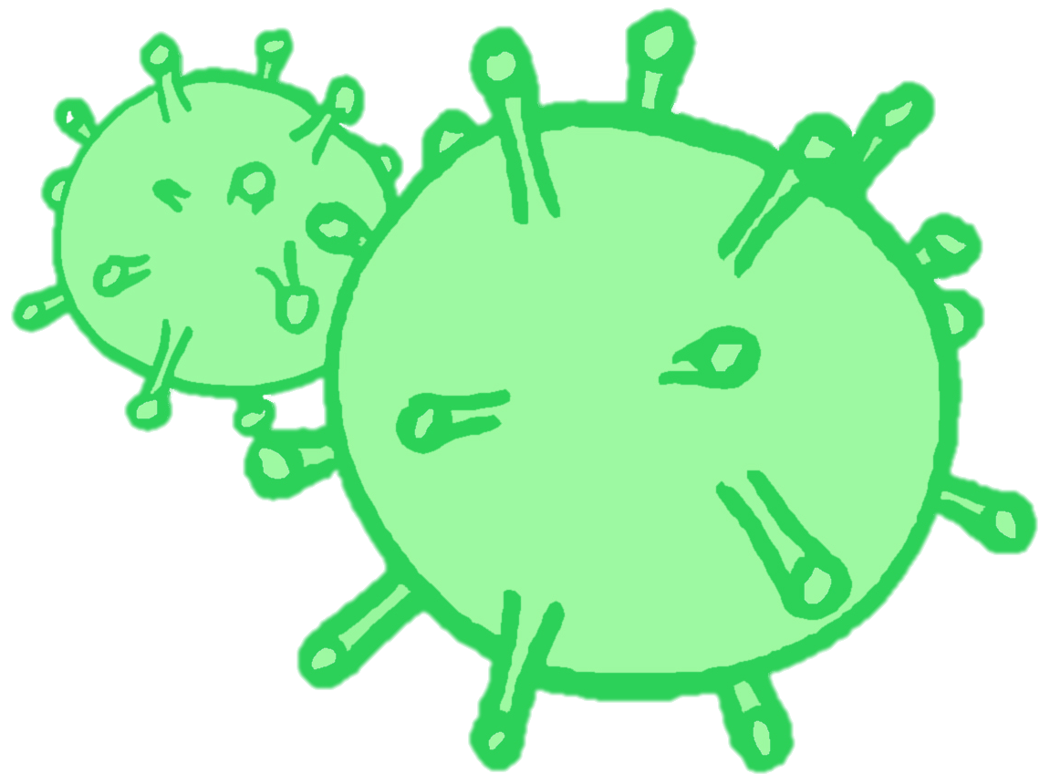
CONTRACEPTION & STI’s
Year 10 Health Lesson 11 Term 2, 2024

Slide 2

Today’s Focus
Task 3: Presentations.
+ complete table as listening.
Investigate online help seeking resources.
Review content learned throughout term 2.

Slide 3
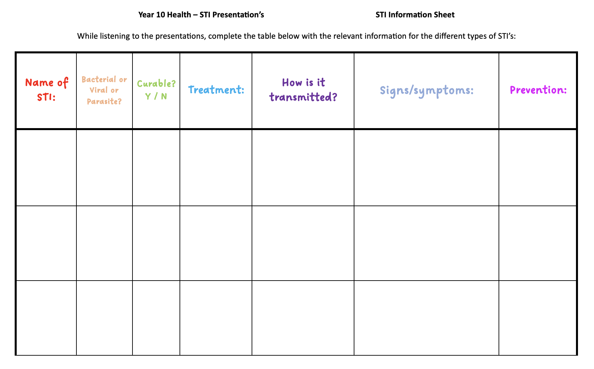
STI Presentations: (pg. 26-27)
Complete the table in your books while listening to other groups present their work.
By the end of the presentations, you will have collected information different types of STI’s.
Notes:
When students are presenting their assignments, the audience will need to complete a table about each different STI that is presented. By the end of the presentations, students will have collated information on all the different STI’s into their workbooks.

Slide 4
Activity 1: Sexual Health – Where to go for help? (pg. 24-25)
By the end of this activity, you will come away with information on 4 different websites or locations you can go to for sexual health advice.
Working in small groups of no more than 4.
Each person is to choose a different website or resource from the list below.
Investigate the different websites you can visit for sexual health and STI advice.
Each person in your group investigates a different source.
You will have 6 minutes to research and complete the table in your book.
You will then present and share your research with your group members and everyone else will fill in your information into their books.
Notes:
OPTIONAL ACTIVITY IF ALL PRESENTATIONS ARE COMPLETED.
ALTERNATIVE
Allow students approx. 10-15mins for students to research 4 resources of their choice (skip the sharing/group work).

Slide 5


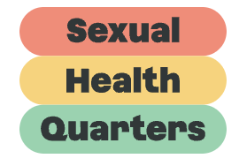

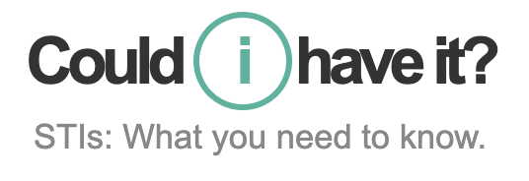


ACTIVITY 1: HELP RESOURCES (pg. 24-25)
WA Gov: Healthy Sexual – https://healthysexual.com.au/
Sexual Health Quarters – https://shq.org.au/helpline/
Get The Facts – https://www.getthefacts.health.wa.gov.au/
Could I Have It? – https://www.couldihaveit.com.au/home
Sexual Assault Resource Centre (SARC) – https://www.kemh.health.wa.gov.au/Other-Services/SARC
Healthy WA STI Factsheets – https://www.healthywa.wa.gov.au/Articles/A_E/About-sexually-transmissible-infections-STIs
Western Australian Aids Council (WAAC) – https://www.waac.com.au/
Notes:
All of these links are included in their books.

Slide 6
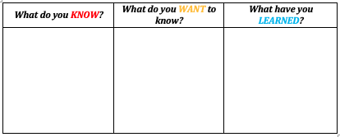
Activity 2: Review – Contraception & STI’s KWL (pg. 9)
This term we have learnt about contraception and Sexually Transmitted Infections (STI’s).
In week 1 you completed the first two columns of the KWL:
What do you already KNOW about contraception and STI’s?
What do you WANT to know about contraception and STI’s?
In week 11 it is now time to complete the third column of the KWL:
What have you LEARNED about contraception and STI’s?
4 minutes to complete

